Slide 1

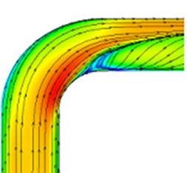
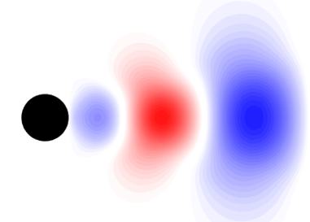
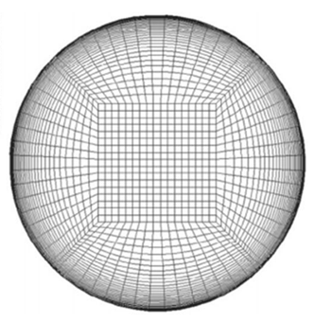

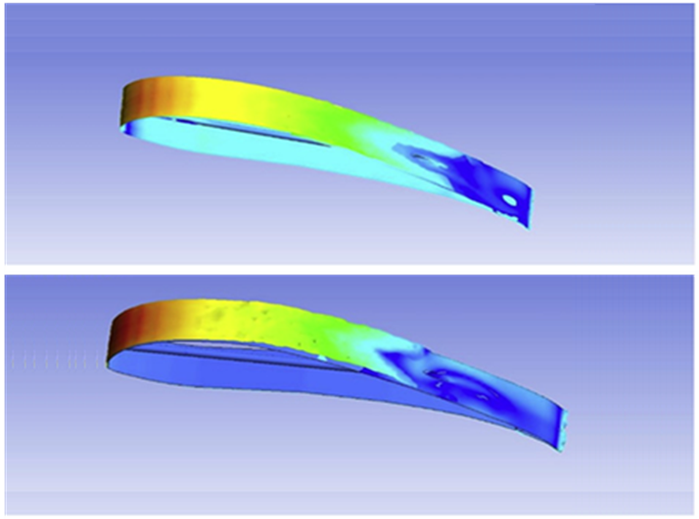
Fluid Mechanics and Computational Intelligence: From Basics to AI/ML Applications
Executive Development Programme
Coordinators
Dr. Nityananda Nandi
Dr. Parikshit Kundu
Dr. T. Nilavarasan
December 15-19, 2025
(Online Mode)
Organized by
Department of Aerospace Engineering and Applied Mechanics
Indian Institute of Engineering Science and Technology, Shibpur
Howrah-711103, West Bengal, India.

Slide 2

IIEST Shibpur is a prestigious institution with rich history dating back to 1856. Its evolution from the “Civil Engineering College” to an “Institute of National Importance” highlights its significance in India's educational landscape. Through its 16 departments and 8 schools across various fields of engineering, science and humanities, the institute presently offers a wide array of programmes at the undergraduate, postgraduate, and doctoral levels, reflecting its commitment to comprehensive education. The institute is situated in the industrial city of Howrah, the institute enjoys 49 hectares of a clean and green campus with a faculty and student strength of 250 and 4000 respectively. With well-equipped laboratories and research centres, the students of IIEST Shibpur have the opportunity to engage in hands-on training that enhances their overall educational experience. As such, the institute today stands out as a centre for academic excellence that not only honours its historical roots but also adapts to contemporary educational needs, making it an attractive choice for aspiring engineers and scientists.
About the institute
The Department of Aerospace Engineering and Applied Mechanics at IIEST Shibpur traces its roots from the Department of Applied Mechanics that was established in 1947. Over the years, the department developed a strong expertise in the areas of fluid mechanics and structural engineering. In 2008, the department officially adopted its current name to reflect its evolving focus on aerospace technologies. The department presently offers undergraduate and postgraduate courses in Aerospace Engineering and also offers another postgraduate course in Hydraulic Engineering. Additionally, doctoral programmes are offered in the broad areas of aerospace and applied mechanical sciences, with major emphasis in areas such as Aerodynamics, Aero-structures, Propulsion, Hydrodynamics and Bio-mechanics. By fostering an environment of innovation, the department not only plays a crucial role in shaping future engineers to tackle contemporary issues in these dynamic fields, but also actively contributes towards advancing sustainable aviation goals.
About the Department of Aerospace Engineering and Applied Mechanics

Slide 3
Course Overview
This interdisciplinary course bridges the foundational principles of fluid mechanics with cutting-edge techniques in computational intelligence, especially data-driven modelling, machine learning (ML) and artificial intelligence (AI). Participants will first develop a solid understanding of classical fluid mechanics and then explore how data-driven approaches are transforming the analysis, modelling and simulation of fluid flows.
The course emphasizes both theoretical understanding and hands-on application, preparing participants for advanced research or industry roles involving computational fluid dynamics (CFD), modal analysis and intelligent control systems.
Course Outcomes
Gain a strong foundation in fluid mechanics fundamentals.
Understand the role of computational intelligence techniques in solving engineering problems.
Learn the integration of AI/ML models with fluid dynamics for real-world applications.
Develop problem-solving skills using modern simulation and predictive tools.
Exposure to case studies and practical demonstrations on industrial applications.

Slide 4
Course Contents
Basics of Fluid Mechanics
Fundamentals of fluids and flow classification
Continuity, Momentum (Navier–Stokes), Energy equations
Boundary layer concepts and flow regimes
Applications in engineering systems
Concept of RANS equations and turbulence modeling
Reynolds decomposition and RANS equations
Boussinesq’s hypothesis
Prandtl’s mixing length
Overview of common RANS models (k-ε, k-ω and S-A)
Validation and verification methods
Introduction to Modern Computational Fluid Dynamics
Introduction to CFD and its necessity in modern engineering
Mathematical foundations and discretization concepts
Grid generation and boundary conditions
Overview of CFD software (e.g., ANSYS Fluent, OpenFOAM)
CFD Workflow, Post-Processing and Data Visualization
Hands on CFD demonstration
Setting up a simple CFD case (flow over flat plate/cylinder)
Solver execution and convergence
Flowfield visualization
Data-driven techniques
Modal analysis of fluid flows
Proper Orthogonal Decomposition (POD)
Dynamic Mode Decomposition (DMD)
Spectral POD (SPOD)
AI/ML in Fluid Mechanics
Introduction to AI/ML concepts for engineers, Workflow: data collection, preprocessing, training, testing, ML tools and frameworks (Python, TensorFlow, PyTorch)
Surrogate modelling for CFD simulations, Data-driven turbulence modelling, Physics-Informed Neural Networks (PINNs), Industrial case studies (aerospace, automotive, biomedical, energy)
Hands-on demo: training a simple ML model for engineering problems.
Integration of CFD + ML results

Slide 5
Course instructors
Dr. Nityananda Nandi, Associate Professor, Department of Aerospace Engineering and Applied Mechanics, IIEST Shibpur
Dr. T. Nilavarasan, Assistant Professor, Department of Aerospace Engineering and Applied Mechanics, IIEST Shibpur
Dr. Parikshit Kundu, Assistant Professor, Department of Aerospace Engineering and Applied Mechanics, IIEST Shibpur
Dr. Mayank Verma, Assistant Research Scientist, The University of Iowa – College of Engineering, USA.
Mr. Azan Parmar, Technical Specialist, Altair
Who can participate
Faculty members from engineering and science disciplines.
Industry professionals working in fluid mechanics, CFD, data analytics, or AI/ML.
Researchers and Ph.D. scholars in mechanical, aerospace, civil, or related fields.
Postgraduate and undergraduate students aspiring to work in computational intelligence and fluid mechanics applications.
Engineers and consultants looking to upskill in modern AI-driven engineering approaches.

Slide 6

Course fee and registration
The registration fee is to be paid online using the following details:
Name: CONTINUING EDUCATION CENTRE BESUS
A/c No.: 1532010011963 IFSC: PUNB0153220
Bank Name: Punjab National Bank
Branch: BESUS
After successful payment, please fill in and submit the Google form (link and QR code given below) with the payment details
https://shorturl.at/5aNZR
Last date of registration: November 30, 2025
Participants | Price | Total amount to be paid
Foreign participants | ₹ 8000 + 18% GST | ₹ 9440
Industry | ₹ 2000 + 18% GST | ₹ 2360
Faculty | ₹ 1500 + 18% GST | ₹ 1770
PhD & PG | ₹ 1000 + 18% GST | ₹ 1180
UG | ₹ 500 + 18% GST | ₹ 590
Note:
Participation link will be provided to registered candidates via email.
Certificate will be provided to the participants upon completion.
Course coordinators
Dr. Nityananda Nandi, Associate. Professor, IIEST Shibpur, nityananda@aero.iiests.ac.in
Dr. Parikshit Kundu, Assistant. Professor, IIEST Shibpur, parikshit@aero.iiests.ac.in
Dr. T. Nilavarasan, Assistant. Professor, IIEST Shibpur, nila@aero.iiests.ac.in

