Slide 1











Inauguration of
PHYSICS DEMONSTRATION LABORATORY
At 4th Floor, Acharya Prafulla Chandra Roy Bhavan
(AN OUTREACH PROGRAMME INVOLVING SCHOOL STUDENTS)
BY
Prof. Parthasarathi Chakrabarti
DIRECTOR, IIEST SHIBPUR
On 15th June, 2023
Invited speaker : Prof. Y. K. Vijay, IIS (Deemed University), Jaipur
Venue: Alumni Seminar Hall, Time 11.30 A.M.
Organized by: Department of Physics, IIEST Shibpur.

Slide 2
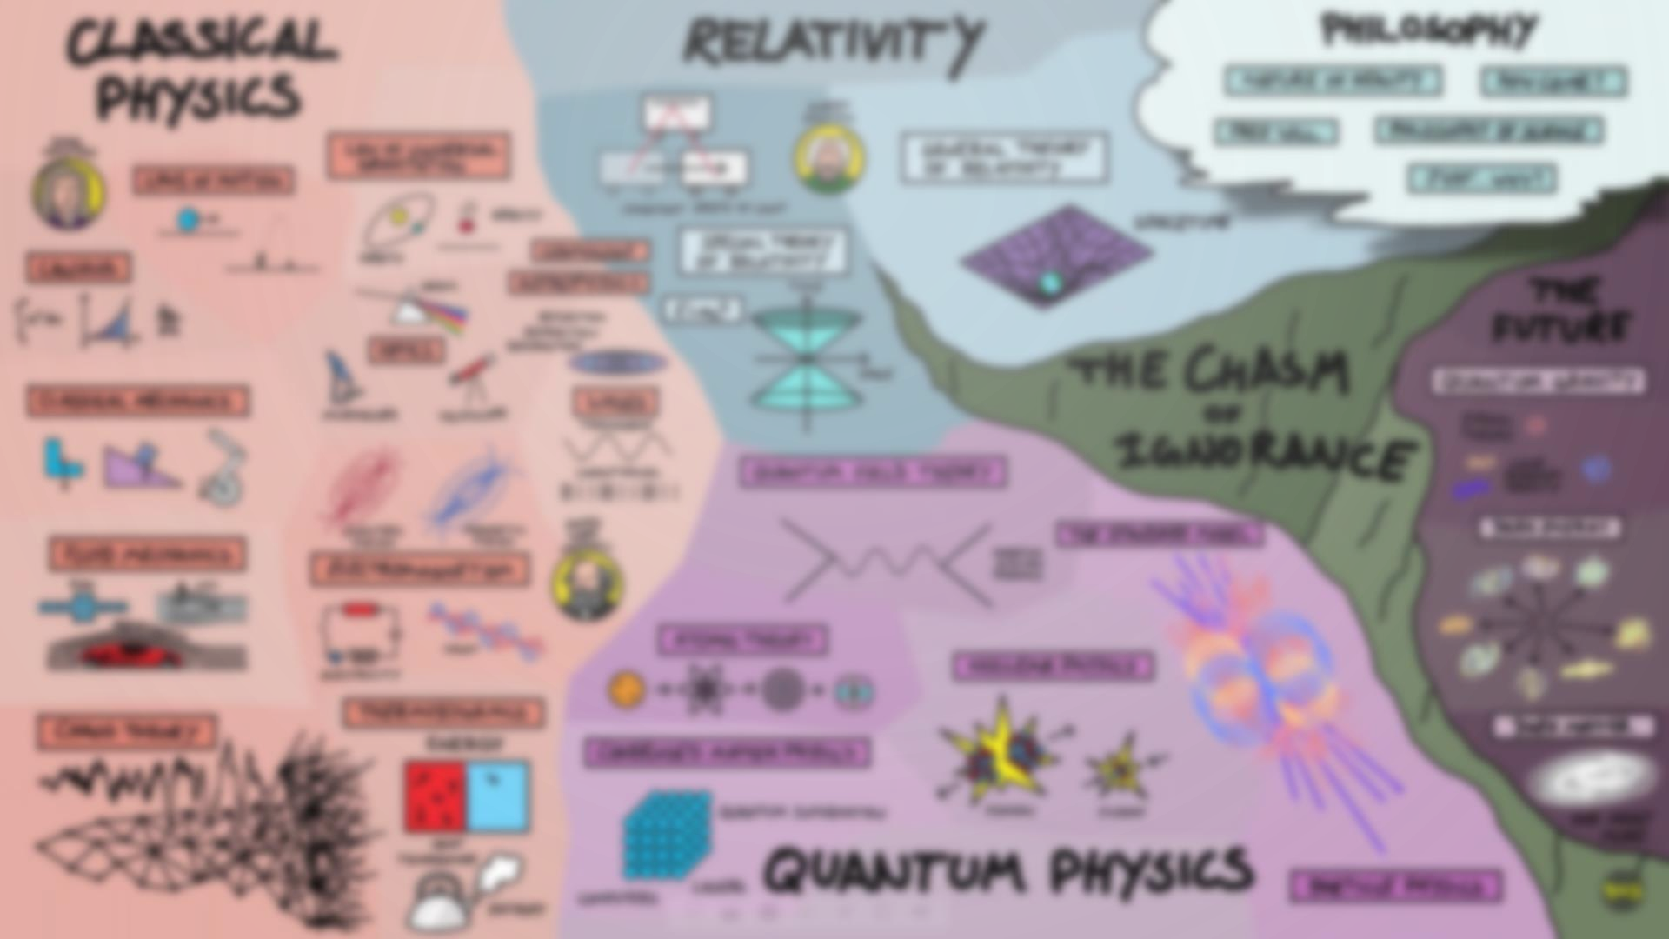

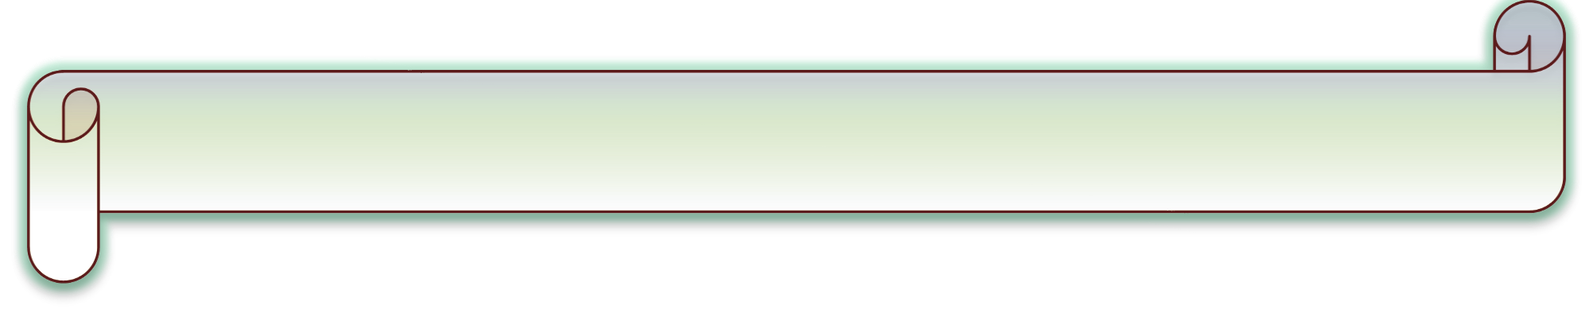











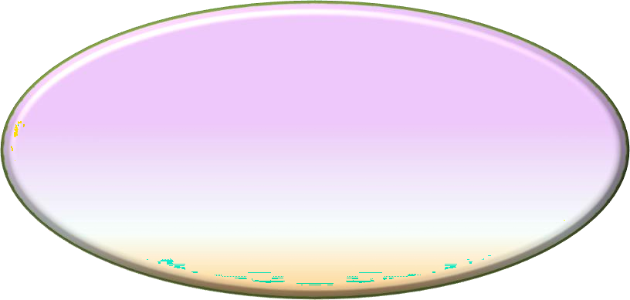





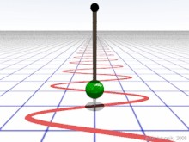
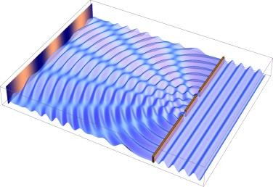




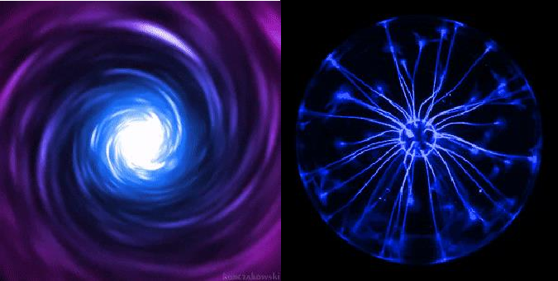

INAUGURATION OF PHYSICS DEMONSTRATION LABORATORY
PROGRAM DETAILS:
OBJECTIVES:
Demonstration Of Experimental Facts To make Scientific Theory More Attractive And Comprehensive to the young curious minds.
Venue: 4th Floor, APC Roy wing, S&T Building
Intended Audiences
School Students
UG & PG students
11:30 am
Curtain raising Of the plaque By Prof. Parthasarathi Chakrabarti, Director, IIEST,SHIBPUR
11:35am-11:55am Laboratory visit by the director
and other dignitaries
Venue: Alumni Seminar Hall, First Floor, S&T Building
Registration link:
12:00pm-12:05pm
12:05pm-12:10 pm
Welcome address By Prof. Dipali Banerjee
On the Occasion - Dr. Syed Minhaz Hossain , Head, Dept. Of Physics, IIEST Shibpur
https://forms.gle/72rVf2FiT3zD2aMf7
12:10pm-12:30 pm
Inaugural Speech By
Prof. Parthasarathi Chakrabarti
Director, IIEST, Shibpur
Organized by
Department of
Physics
IIEST, Shibpur
12:30pm-1:25pm
Demonstration of the setup by
Prof. Y.K. Vijay, IIS( Deemed University), Rajasthan IAPT, RC-6
Vote Of Thanks Break
Demonstration of the laboratory
1:25pm-1:30pm
1:30pm-2:00pm
2:00pm-3:30pm

